Slide 1
Predicting the S&P 500 with Machine Learning
Presented by: GHINEA Andrei
DIACONU Bianca

Slide 2
Table of contents
01
02
03
Project Overview
Dataset Overview
Data Analysis
04
05
06
Feature Engineering
Training Process
Results & Conclusions

Slide 3
Project Overview
Goal: Predict the S&P 500 index value for multiple future time horizons (1, 7, 14, 21, 28 days ahead).
Dataset: 34-year daily stock dataset (1990–2024)
Approach:
Feature Engineering for better trend detection.
Using three different regression models.
Optimizing hyperparameters using Optuna.

Slide 4




Dataset Overview: Key Financial & Economic Data
34 years (1990–2024) of financial data
Category | Examples | What It Measures?
Stock Market | sp500, djia, hsi | U.S. & Global Market Trends
Trading Volume | sp500_volume, djia_volume | Investor Activity & Liquidity
Economic Factors | joblessness, us3m, ads | Employment, Interest Rates & Growth
Risk Metrics | vix, epu, GPRD | Volatility, Policy & Geopolitical Risk

Slide 5
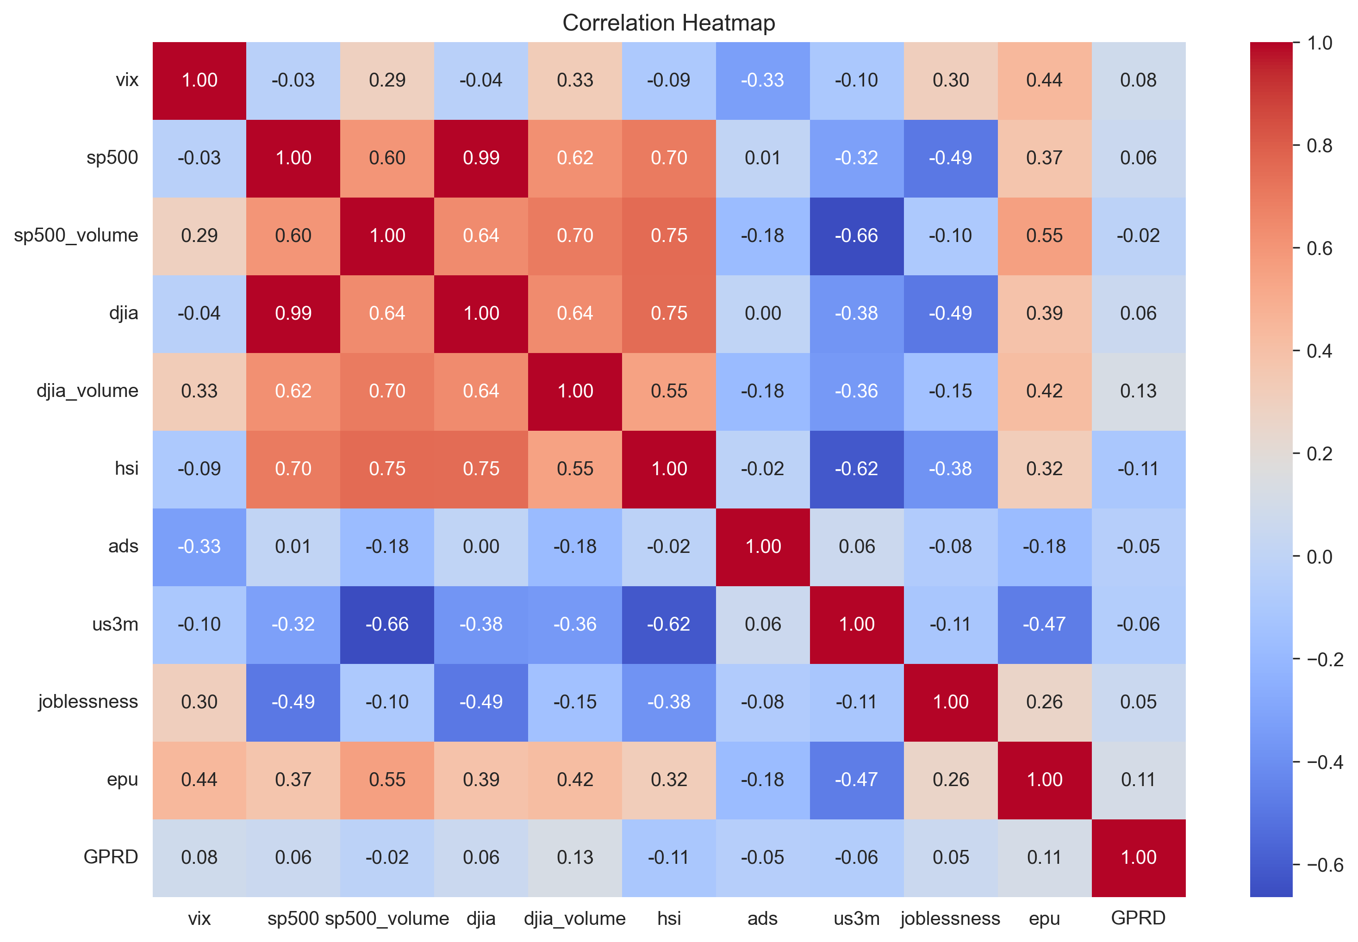

Slide 6
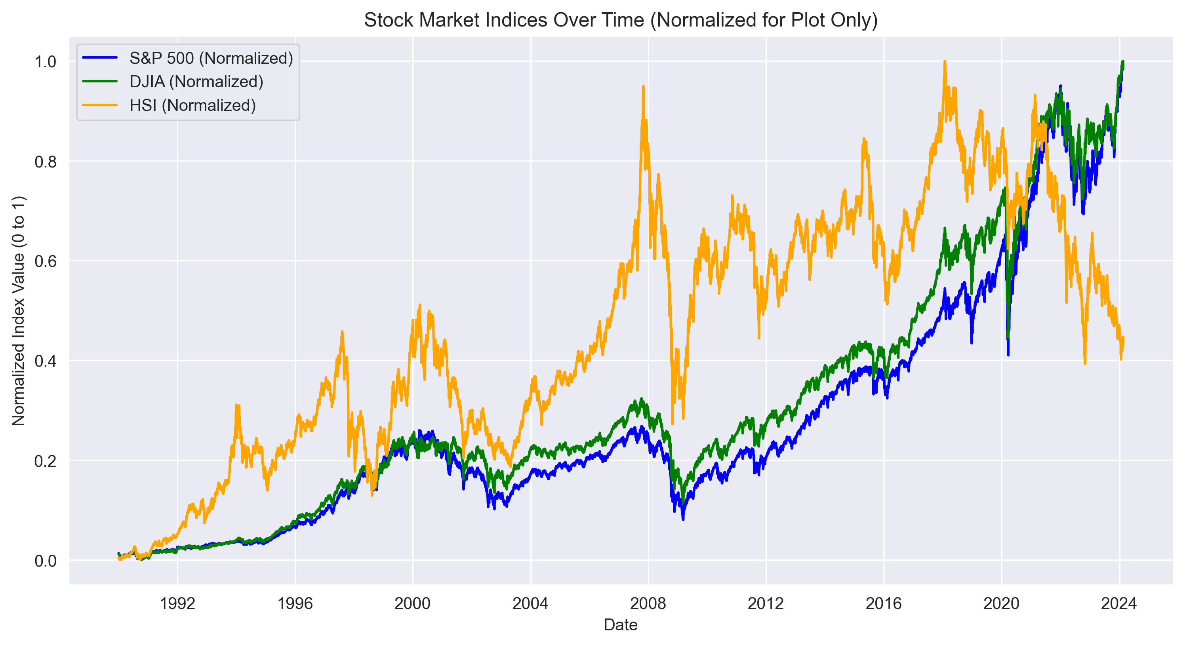
Notes:
Dow Jones Industrial Average (DJIA), another key U.S. market index.
Hang Seng Index, representing the Hong Kong stock market.
S&P 500 index value, a benchmark of the U.S. stock market.

Slide 7
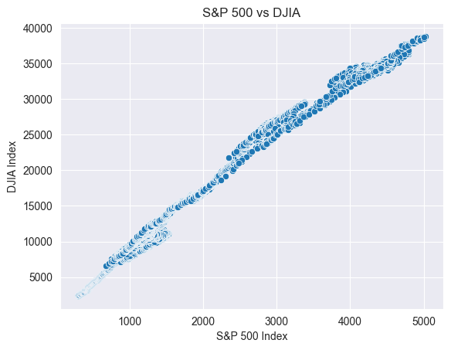

Slide 8
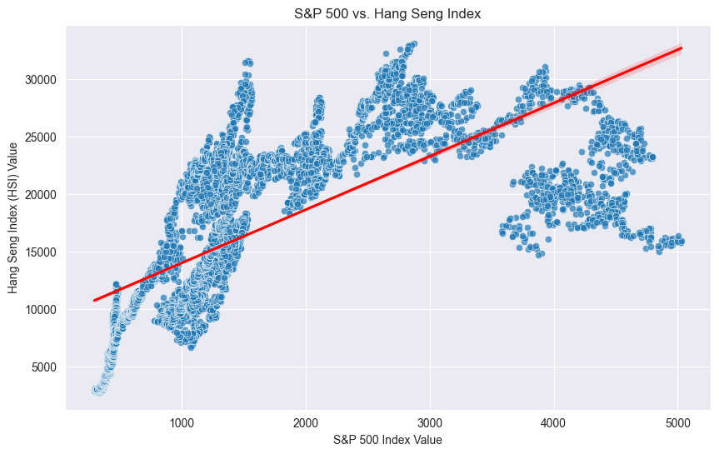

Slide 9
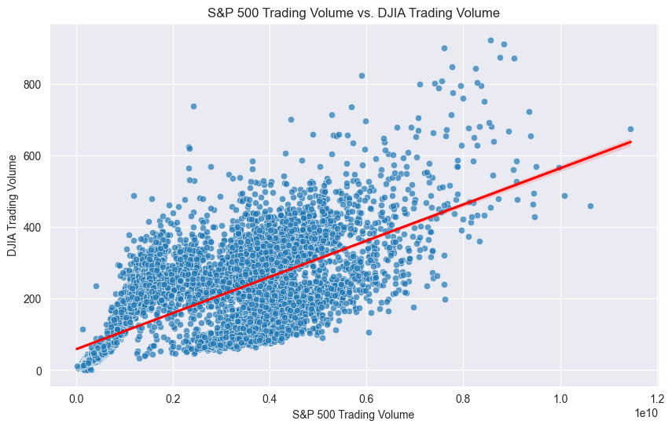

Slide 10
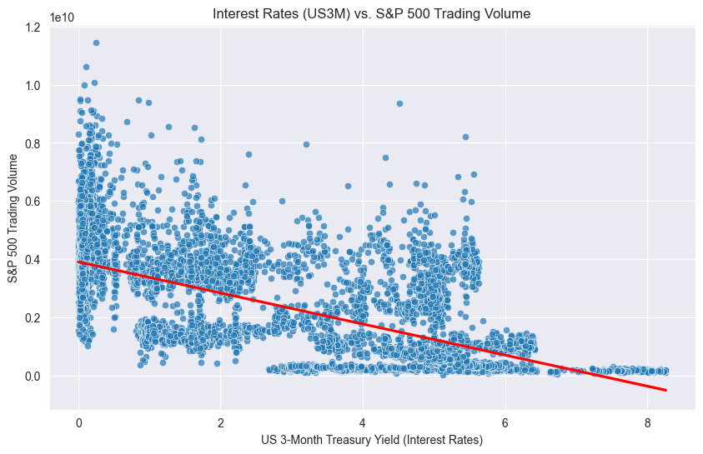

Slide 11
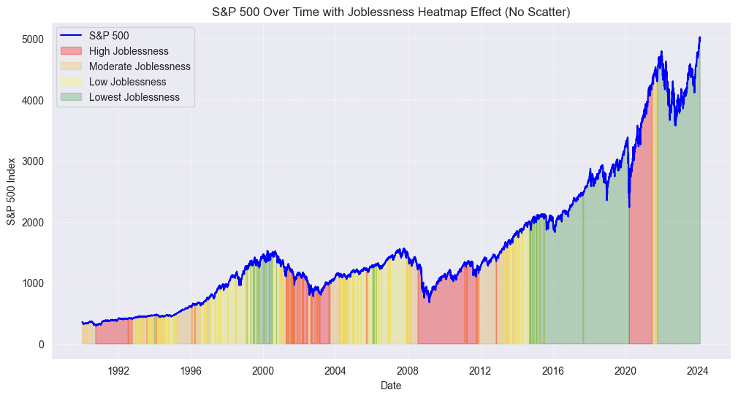

Slide 12
Feature Engineering Creating features that capture market trends & relationships
Rolling Window Features
Mean and standard deviation computed over 7, 14, 30, 90, and 365 days.
Purpose: Capture short, medium, and long-term trends.
Embeddings from Lagged Features
Purpose: Preserve past market patterns, from 1 to 365 days.
Trained an autoencoder to extract latent features.
Reduce high-dimensional lagged features into a compact representation (from 2202 to 24).
Notes:
High dimensional like 365 for each original feature used, such as the S&P 500 and Dow Jones Industrial Average

Slide 13
Tested Models
01
02
03
Linear
Regression
Ridge
Regression
Support
Vector
Regression
(SVR)
Notes:
*Linear Regression (Baseline)*
- Simple and interpretable.
- Surprisingly effective for short-term predictions.
*Ridge Regression*
- Adds L2 regularization to handle multicollinearity.
- Tuned using Optuna for optimal hyperparameters.
*Support Vector Regression (SVR)*
- Non-linear model with RBF kernel for capturing complex relationships.
- Also tuned using Optuna.

Slide 14
Hyperparameter Tuning - Optuna
Used Optuna in the:
Autoencoder
Ridge Regression
Support Vector Regression (SVR)
Notes:
- *Tuning Parameters for Ridge & SVR:*
- *Ridge:* α (L2 penalty) optimized.
- *SVR:* Kernel parameters (C, epsilon, gamma) optimized.
- *Tuning the Autoencoder:*
- Encoding dimension (10–30)
- Hidden layer size (128–512)
- Dropout rate (0.1–0.3)
- Learning rate, L1 penalty, weight decay

Slide 15
Training Process
Data Preparation
Train-test split (80%-20% based on time).
Ensured only past data was used for predictions.
Used both the original features and the newly created ones.
Prediction Targets
Next 1, 7, 14, 21, 28 days.
Notes:
Data Preparation
We applied an 80-20 train-test split, ensuring that the split was based on time to prevent data leakage and maintain a realistic forecasting setup.
The training dataset only used historical data up to a given point, while the test set included future dates that the model had not seen.
We incorporated both raw features (such as S&P 500 values, trading volumes, and macroeconomic indicators) and engineered features like rolling statistics and autoencoder embeddings.
Prediction Targets
Instead of just predicting the next day's value, we extended the forecasting horizon to 1, 7, 14, 21, and 28 days into the future.
This multi-step prediction approach allows us to evaluate how well different models handle both short-term and medium-term forecasts.
It also helps assess the model’s ability to capture trend persistence and market fluctuations over different timeframes.

Slide 16
Results
Days | Linear Regression |  | Ridge Regression |  | SVR
 | MSE | R² | MSE | R² | MSE | R²
1 | 0 | 1 | 0 | 1 | 0.0007 | 0.975
7 | 0.0003 | 0.99 | 0.0002 | 0.991 | 0.0006 | 0.977
14 | 0.0007 | 0.974 | 0.0006 | 0.976 | 0.0011 | 0.958
21 | 0.00095 | 0.964 | 0.0009 | 0.965 | 0.001 | 0.962
28 | 0.00115 | 0.956 | 0.0011 | 0.959 | 0.0014 | 0.948
Notes:
Best Model for Short-Term Predictions (1 Day Ahead):
Ridge Regression (R² = 0.9995)
Best Model for Long-Term Predictions (28 Days Ahead):
Ridge Regression (R² = 0.9593)
SVR performed worse than expected, likely due to its sensitivity to feature scaling.

Slide 17
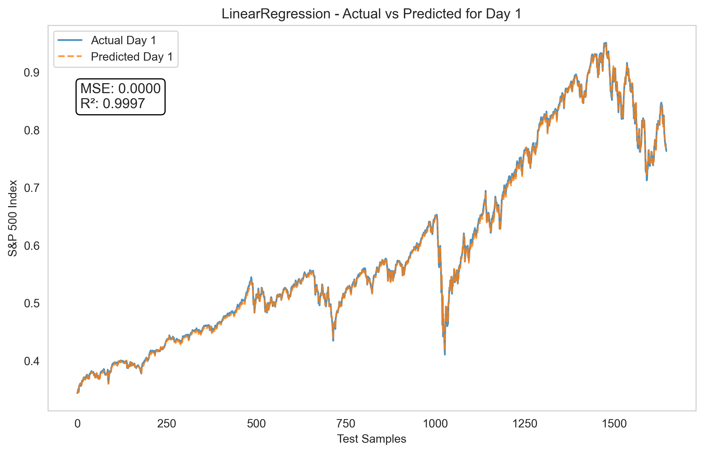

Slide 18
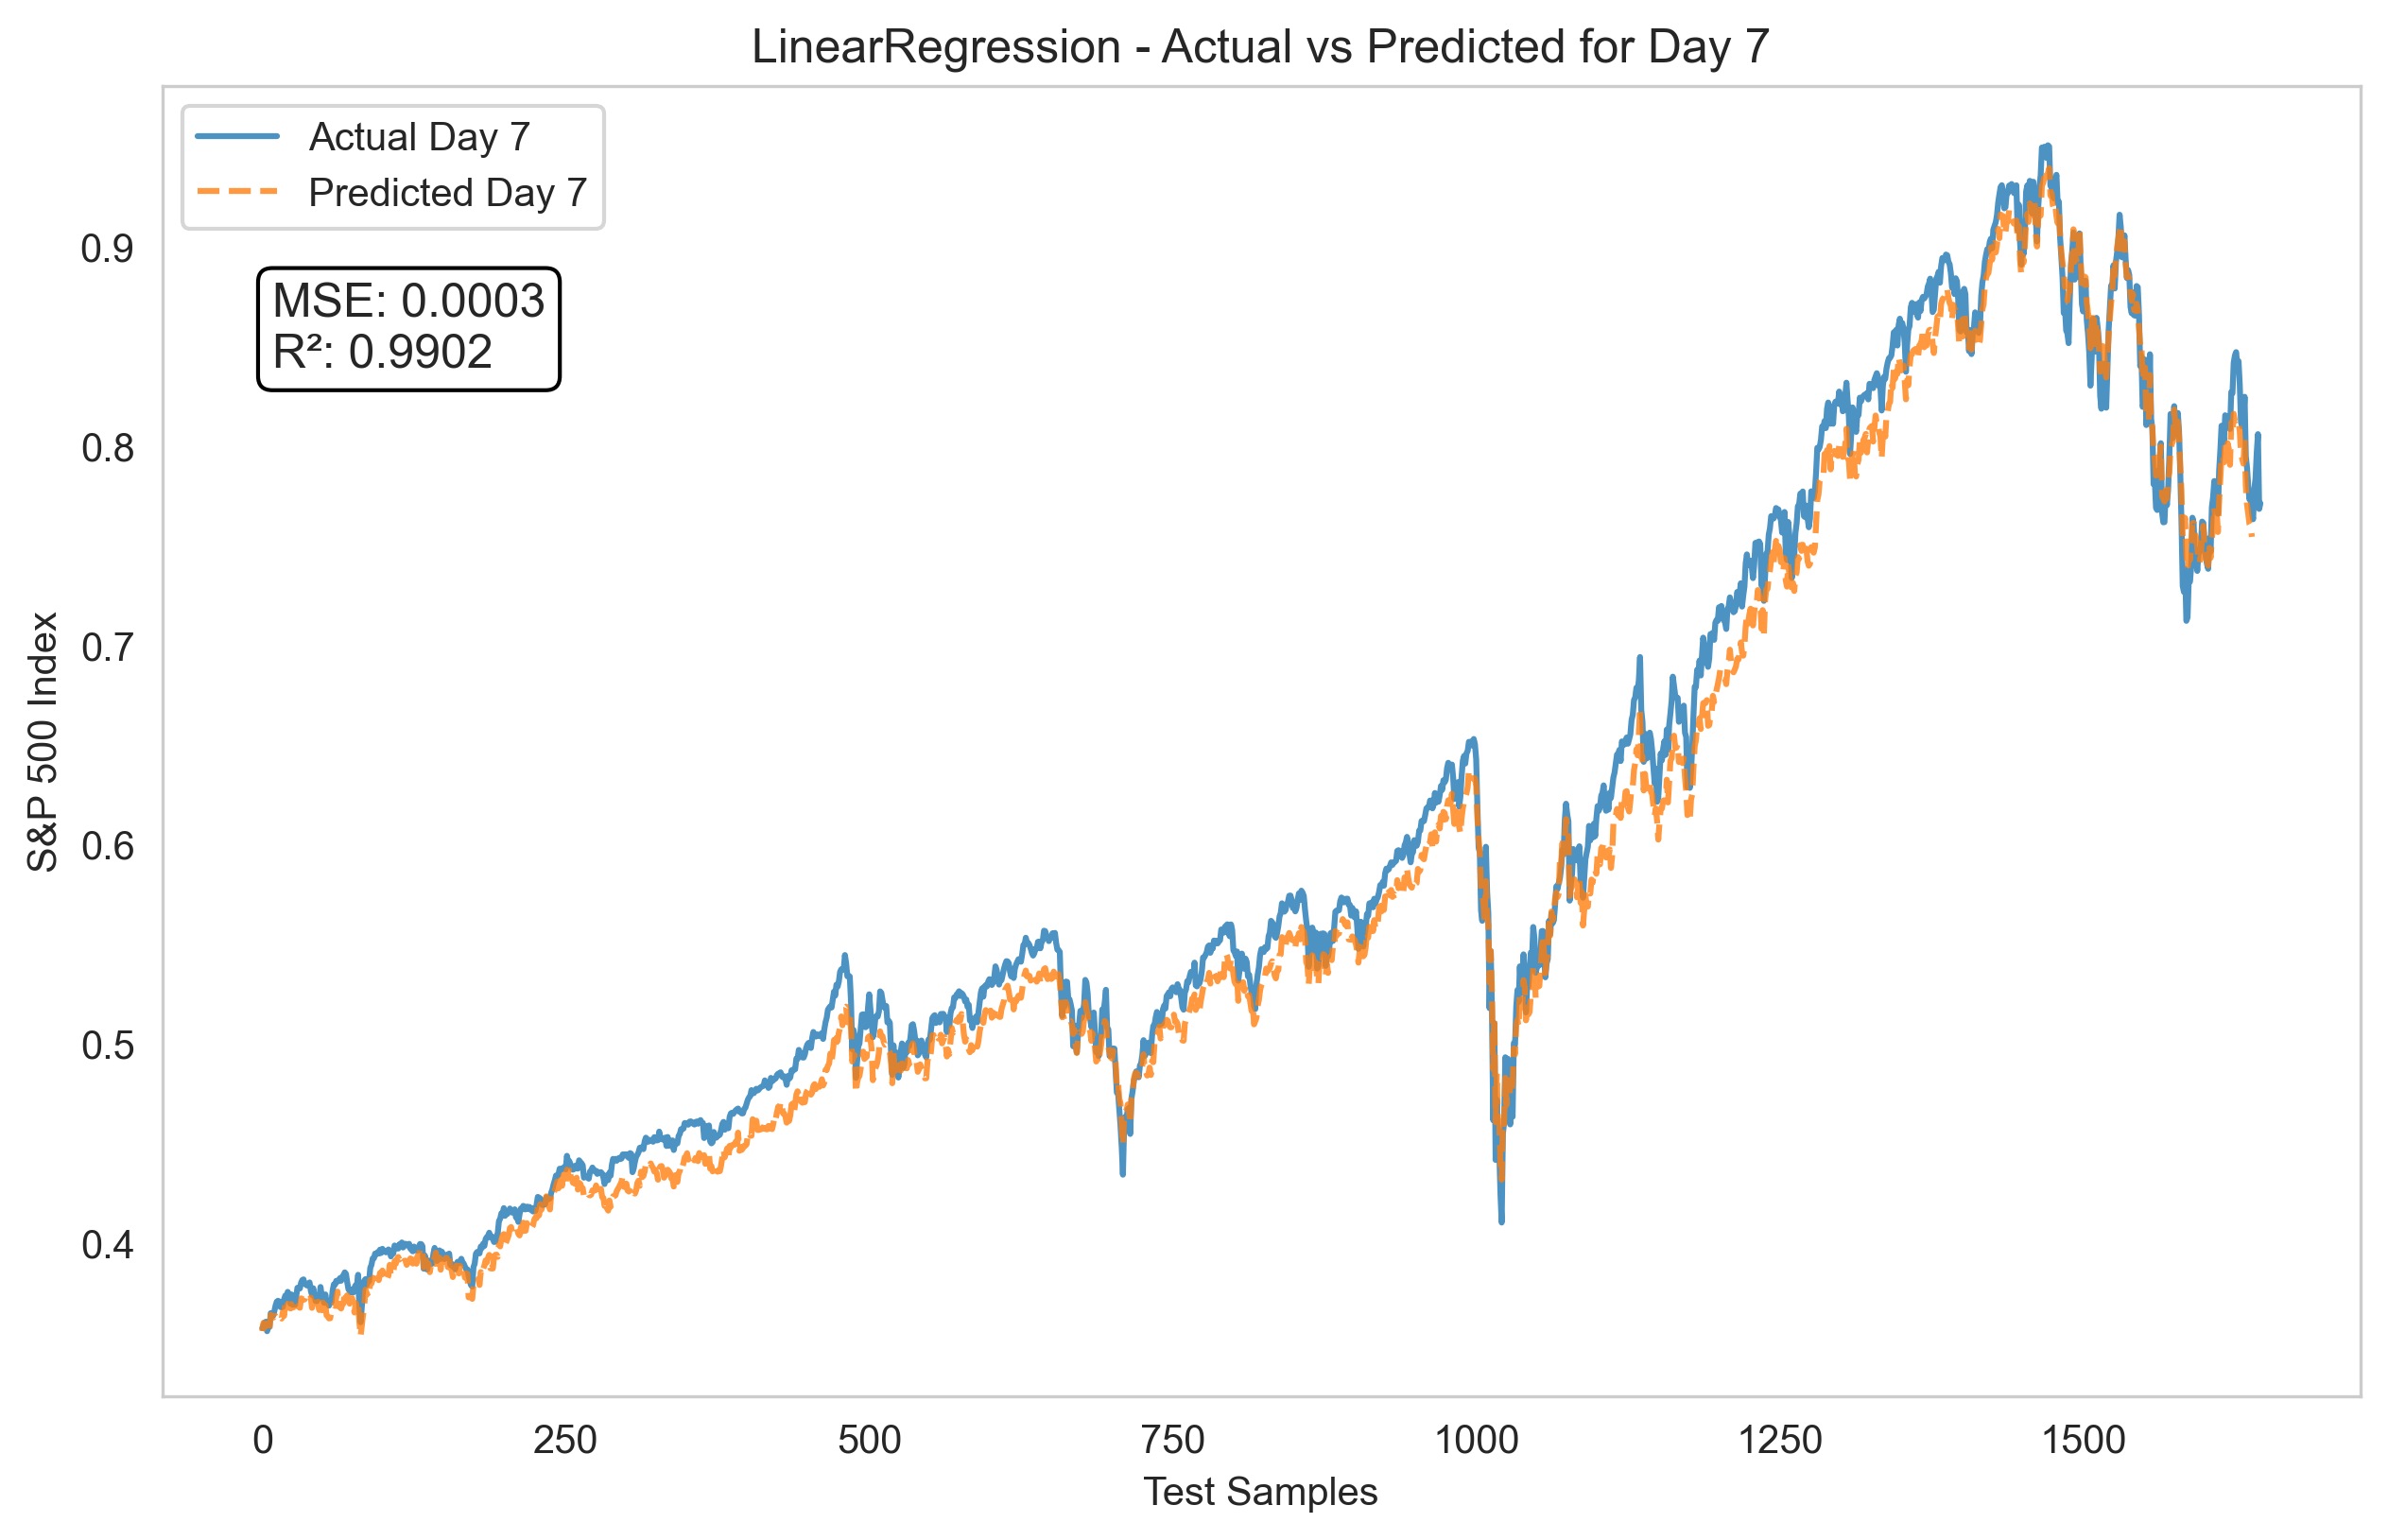

Slide 19
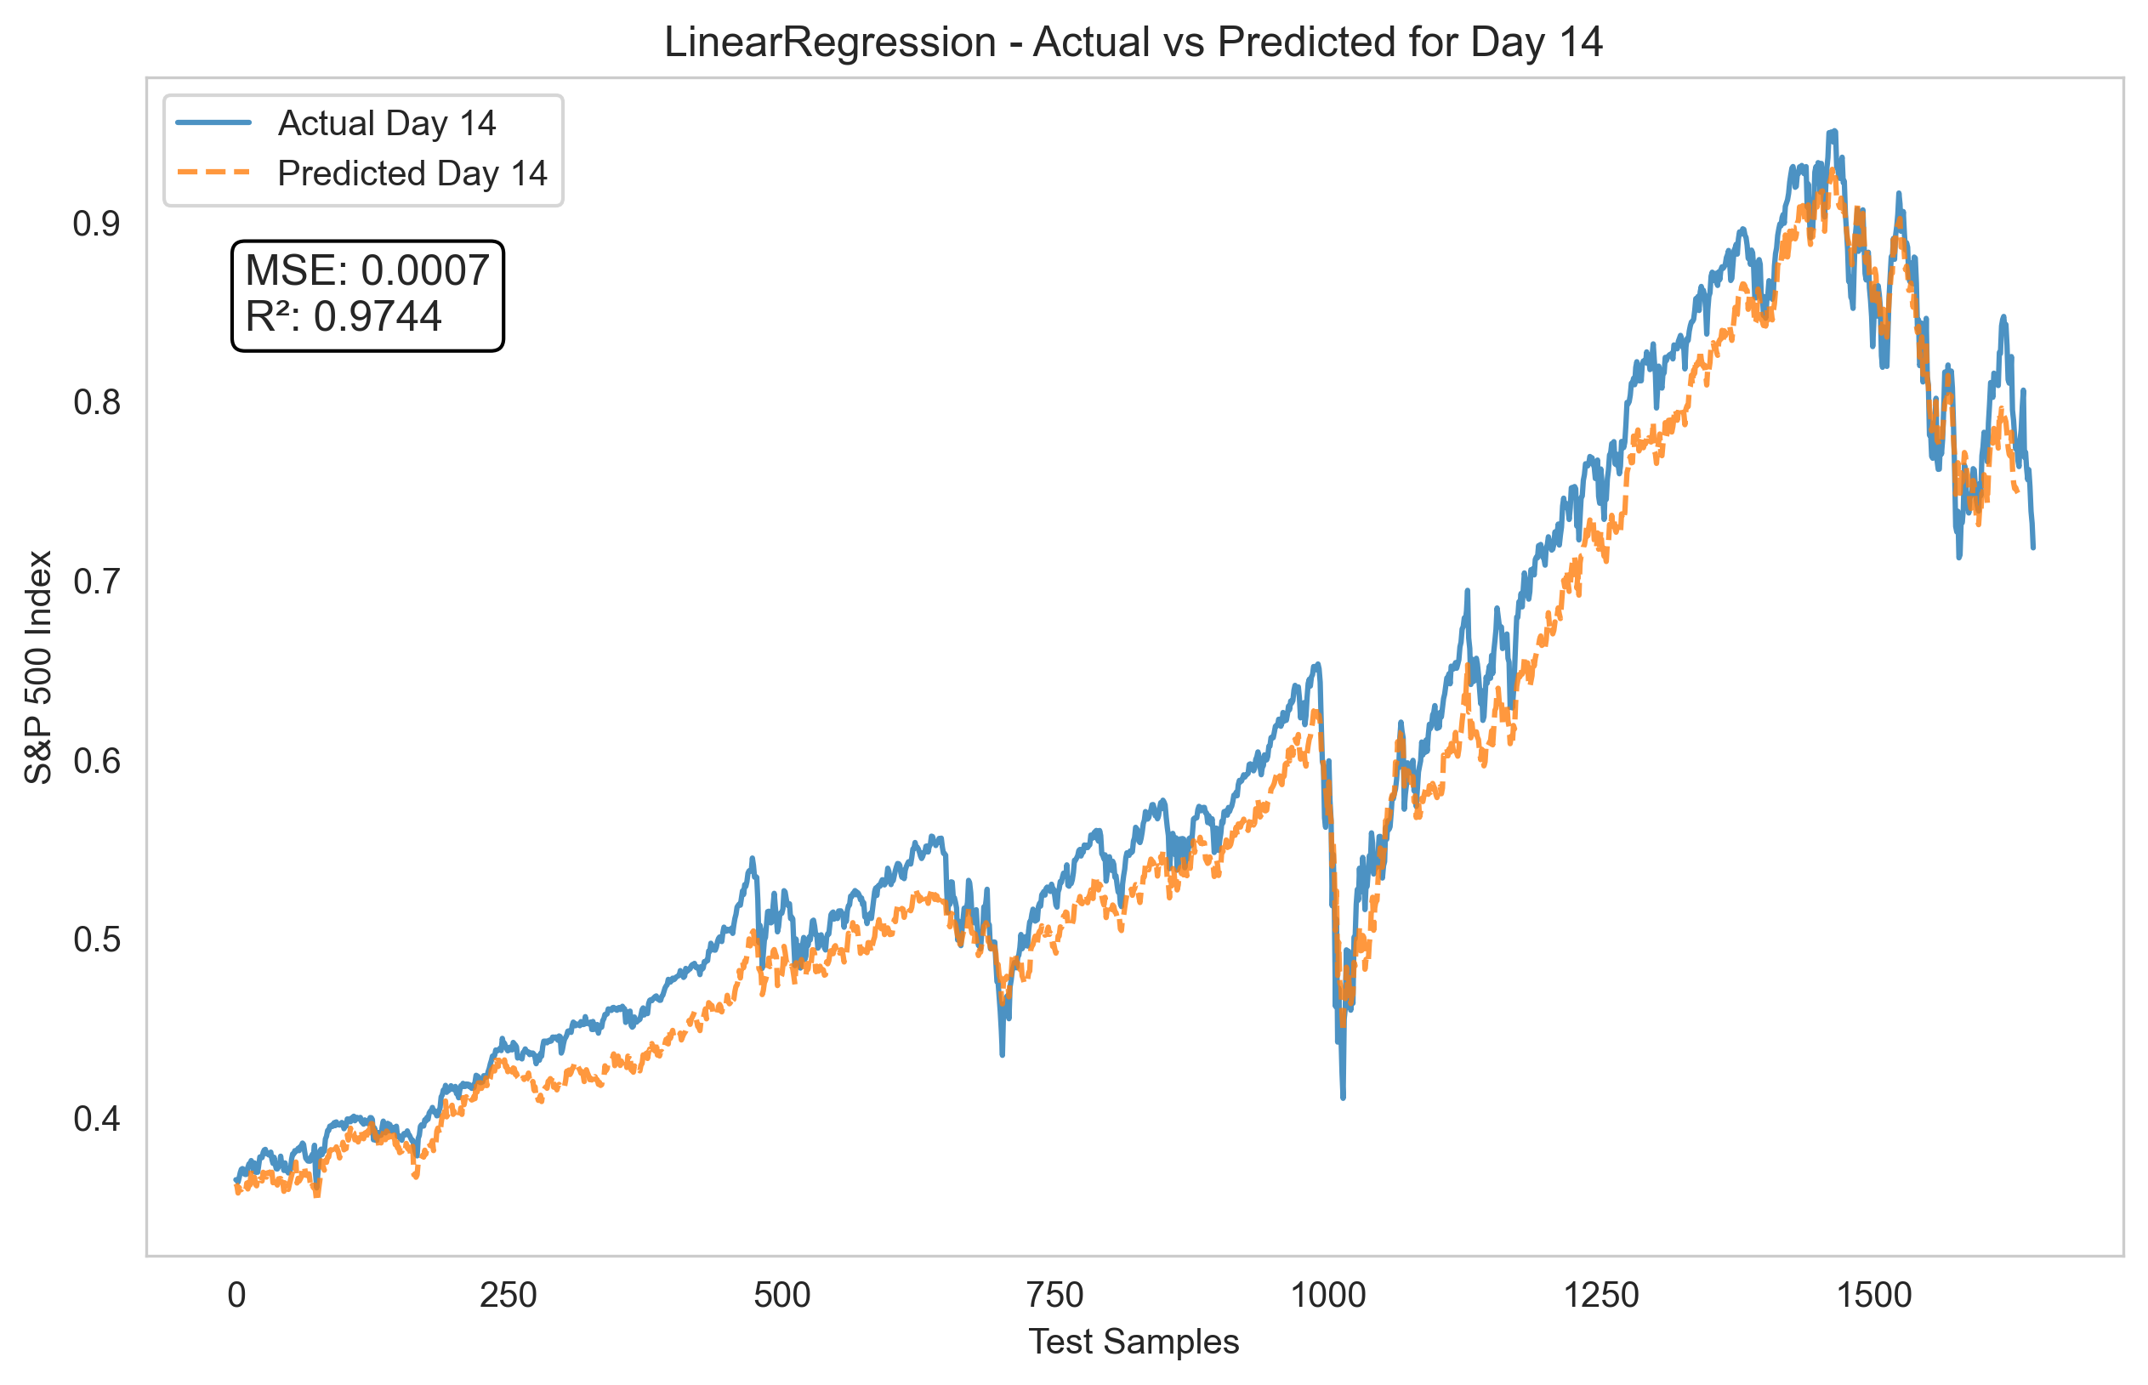

Slide 20
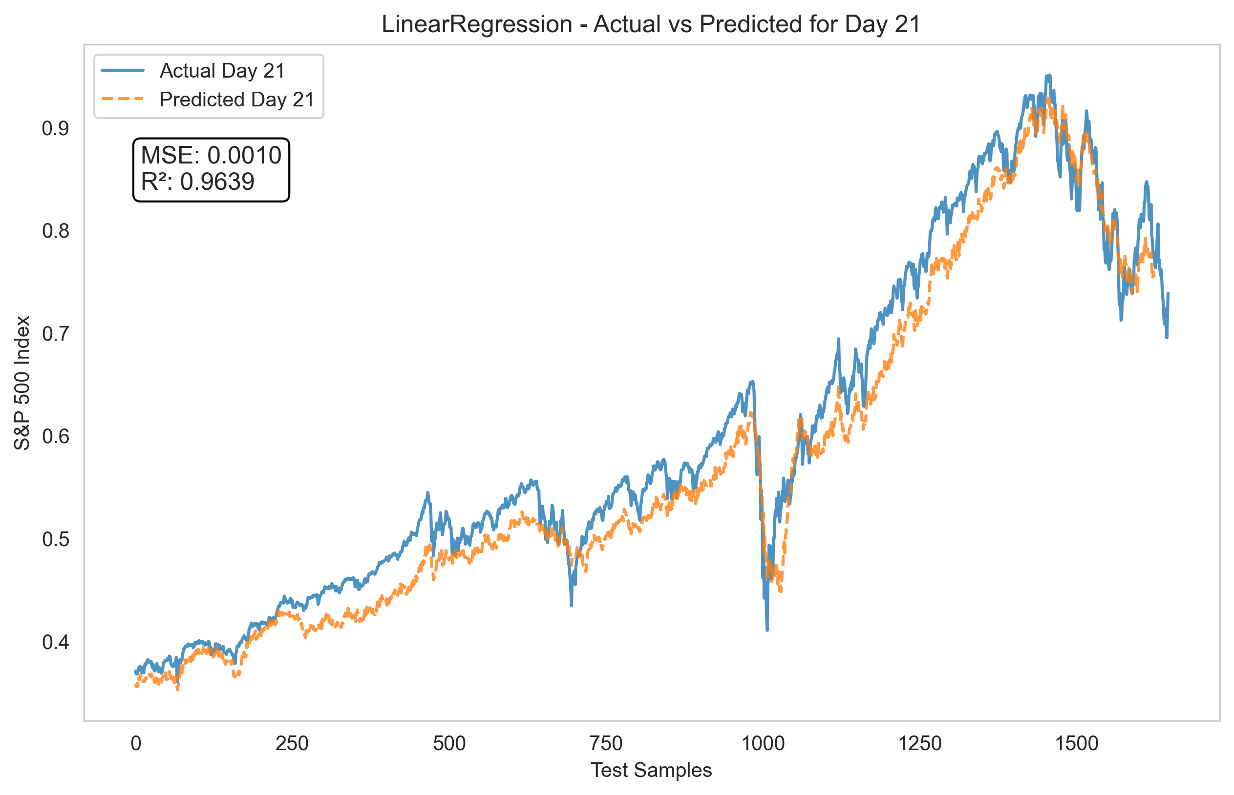

Slide 21
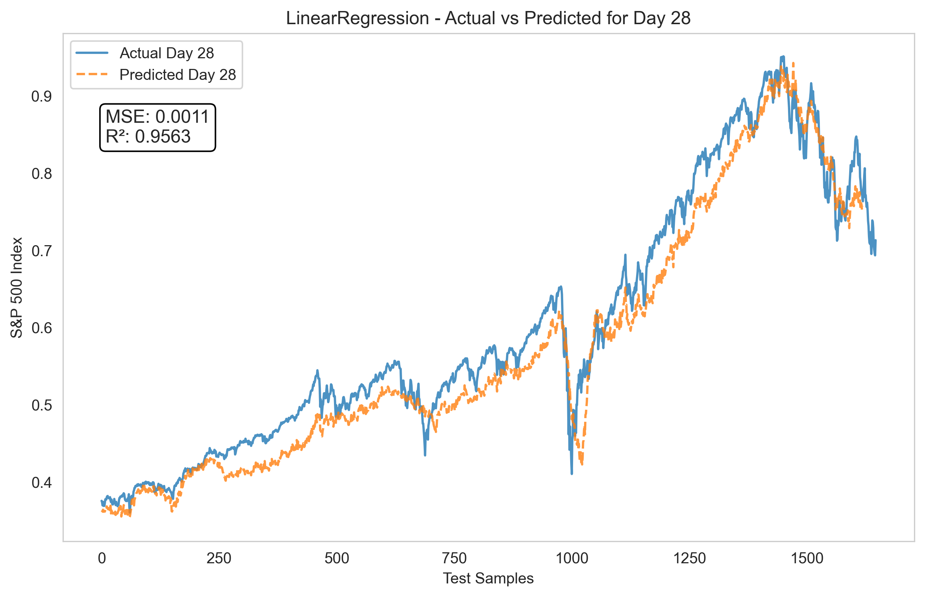

Slide 22
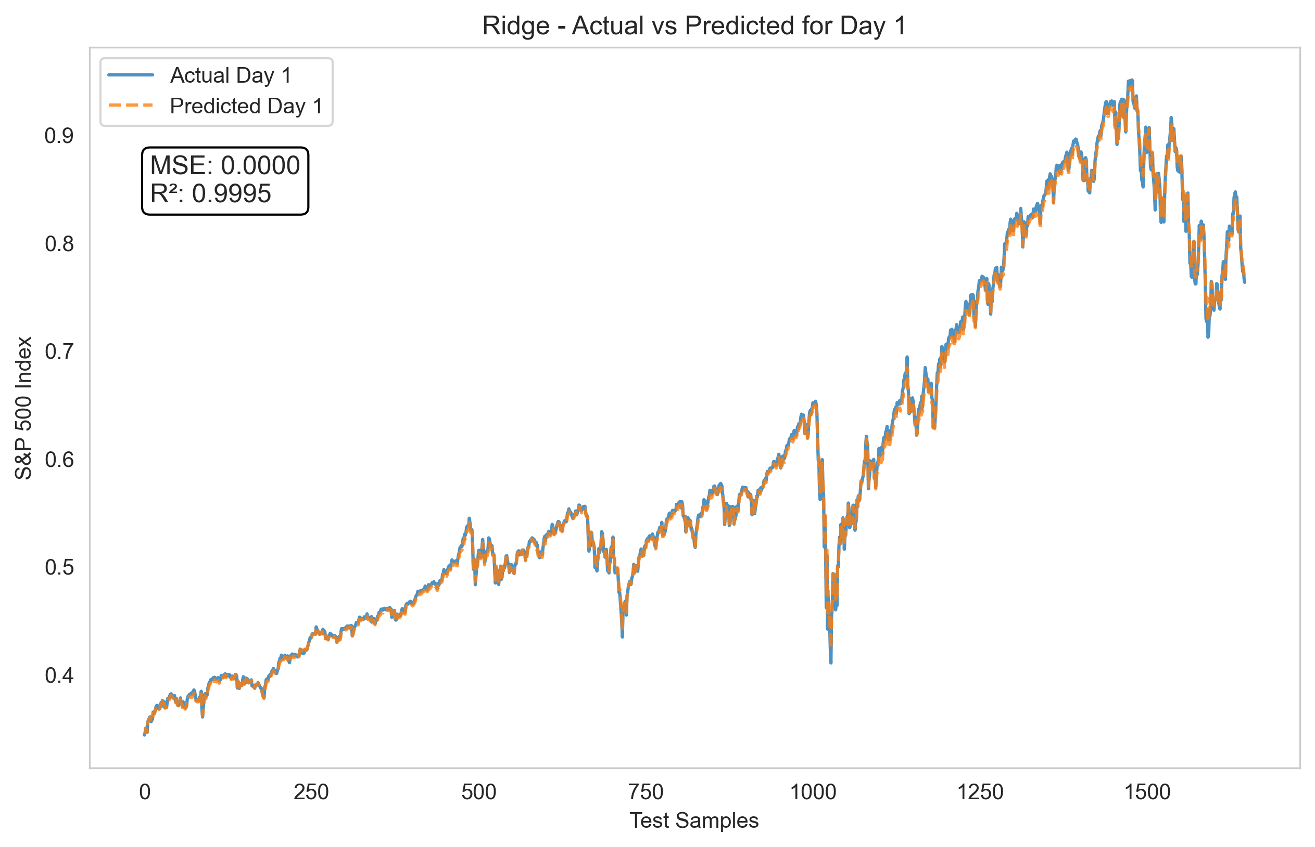

Slide 23
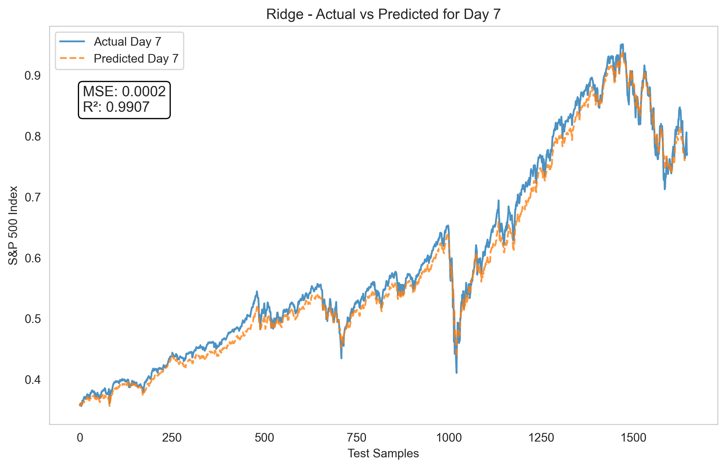

Slide 24
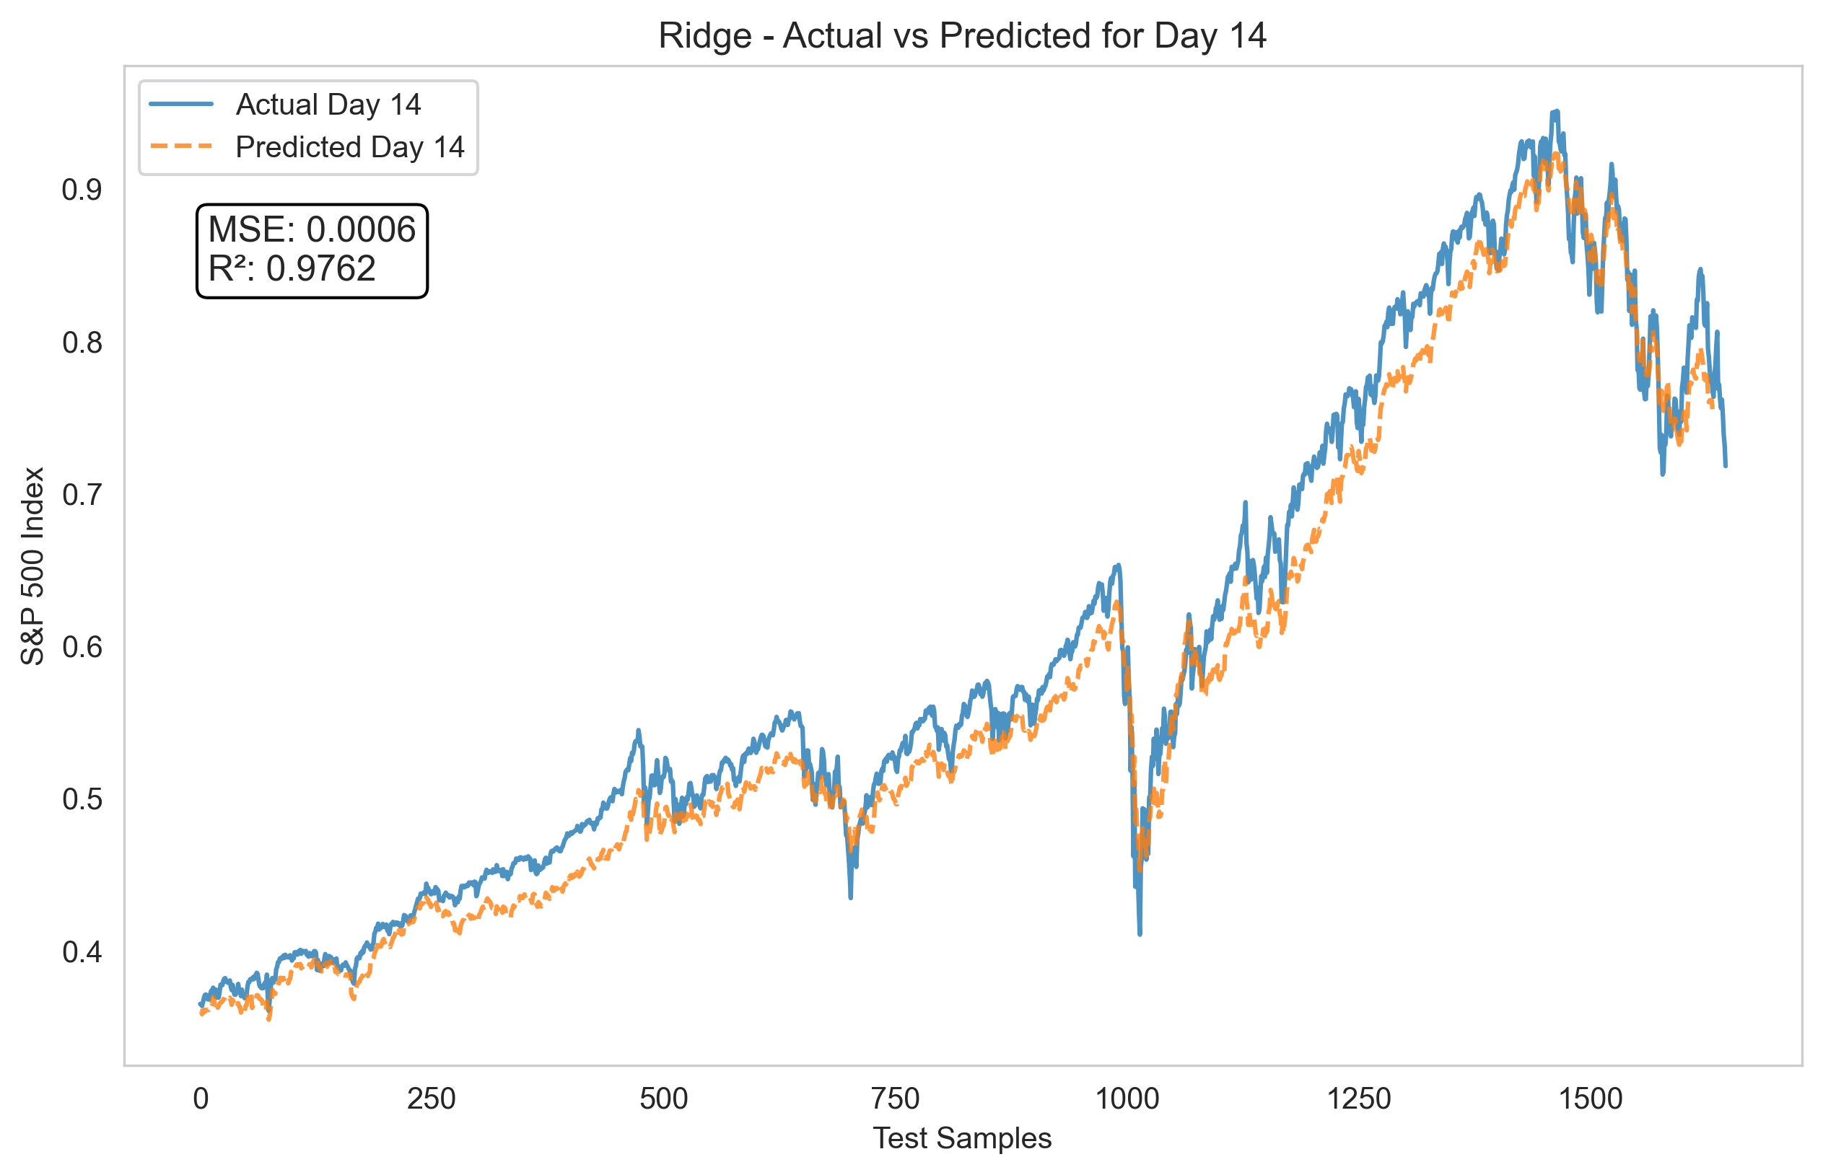

Slide 25
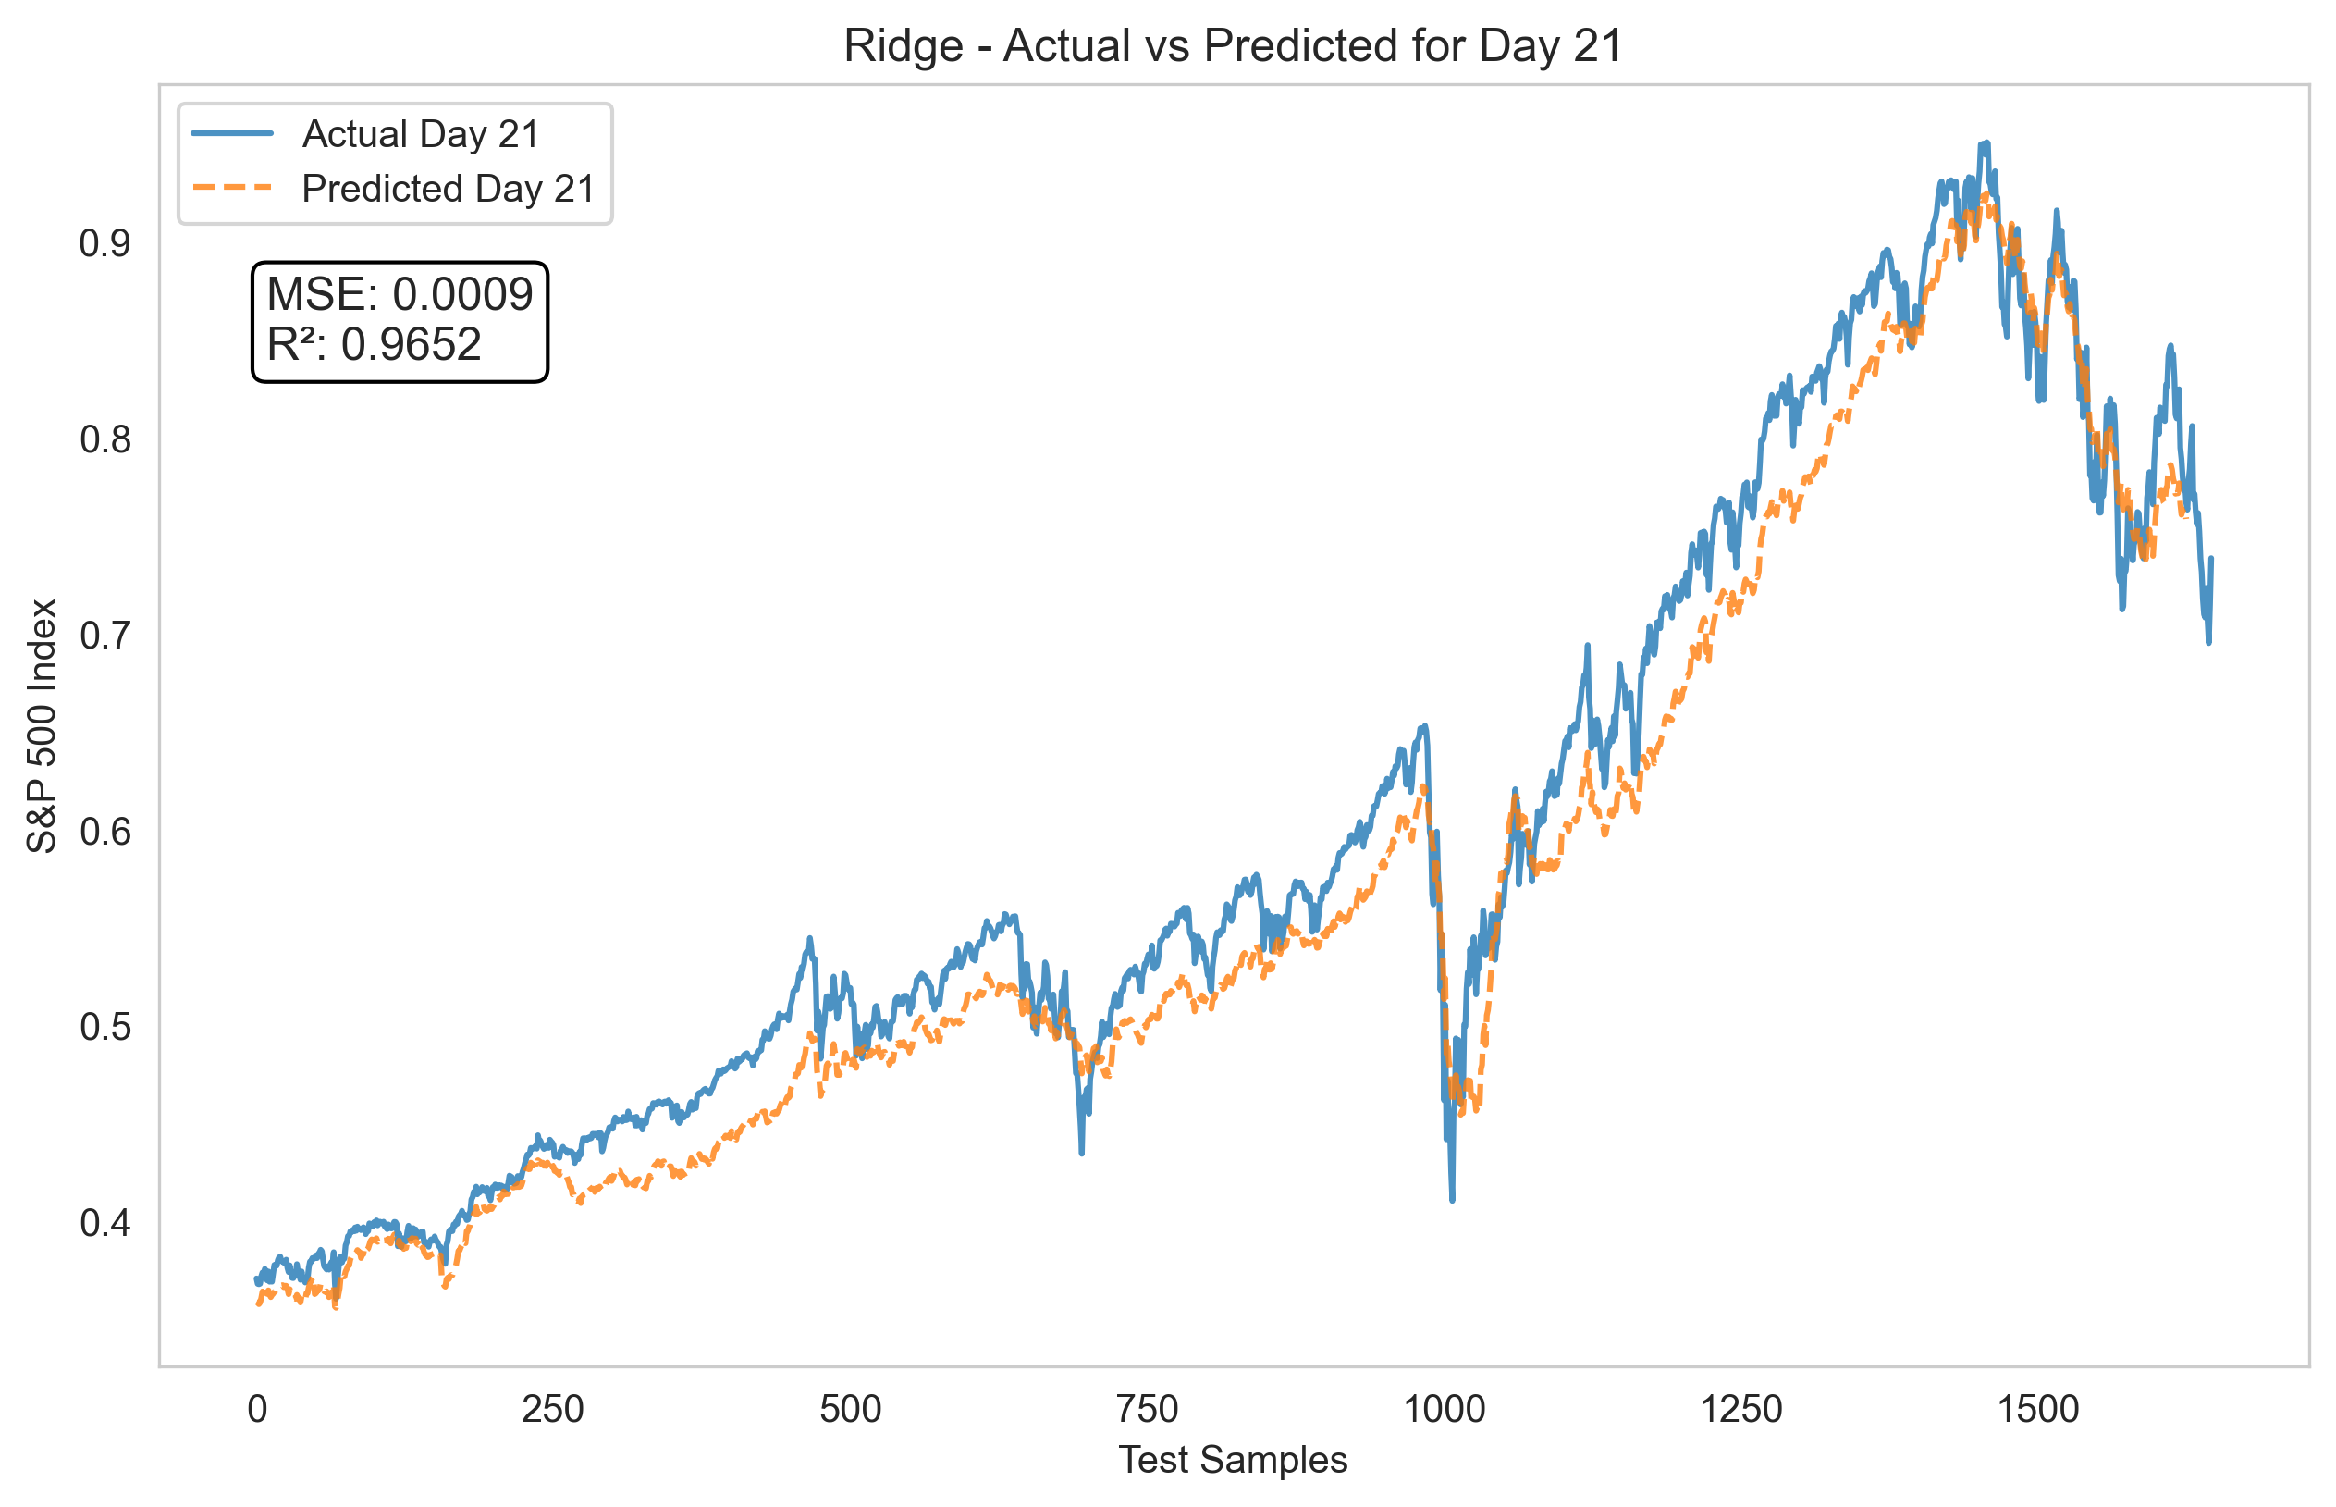

Slide 26
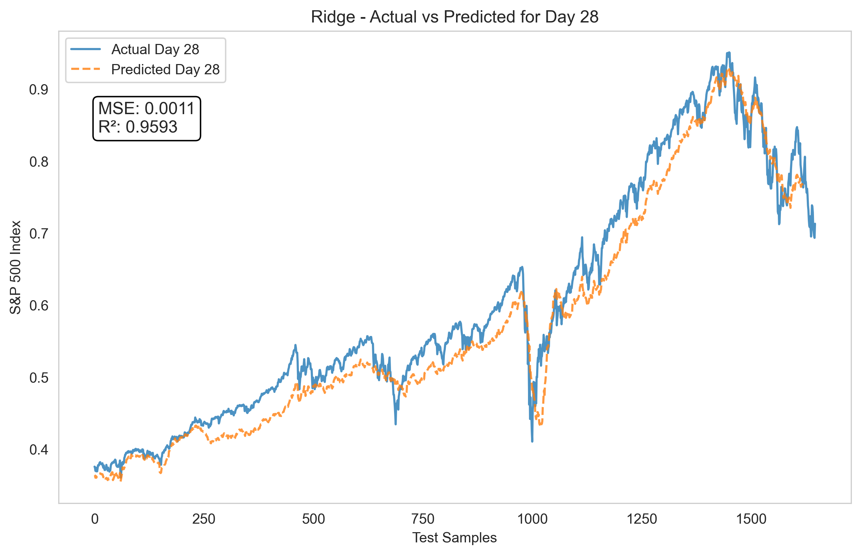

Slide 27
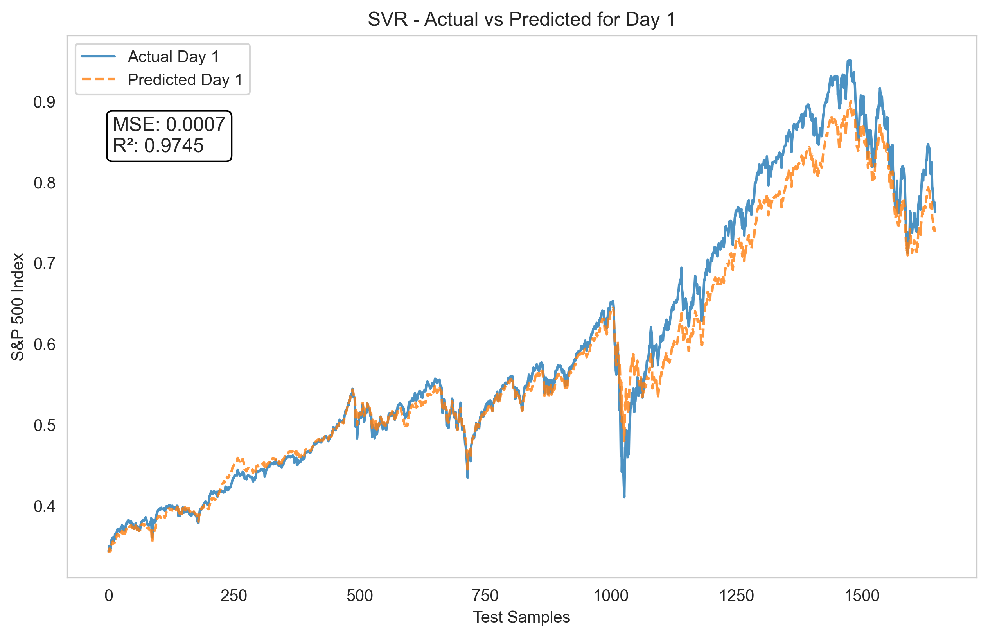

Slide 28
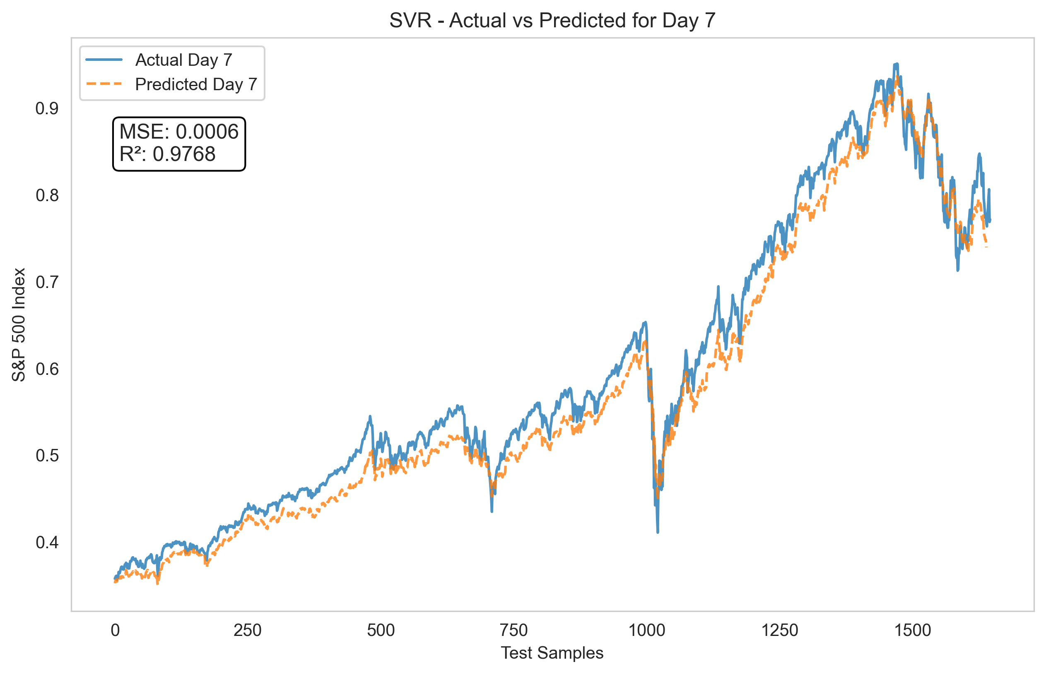

Slide 29
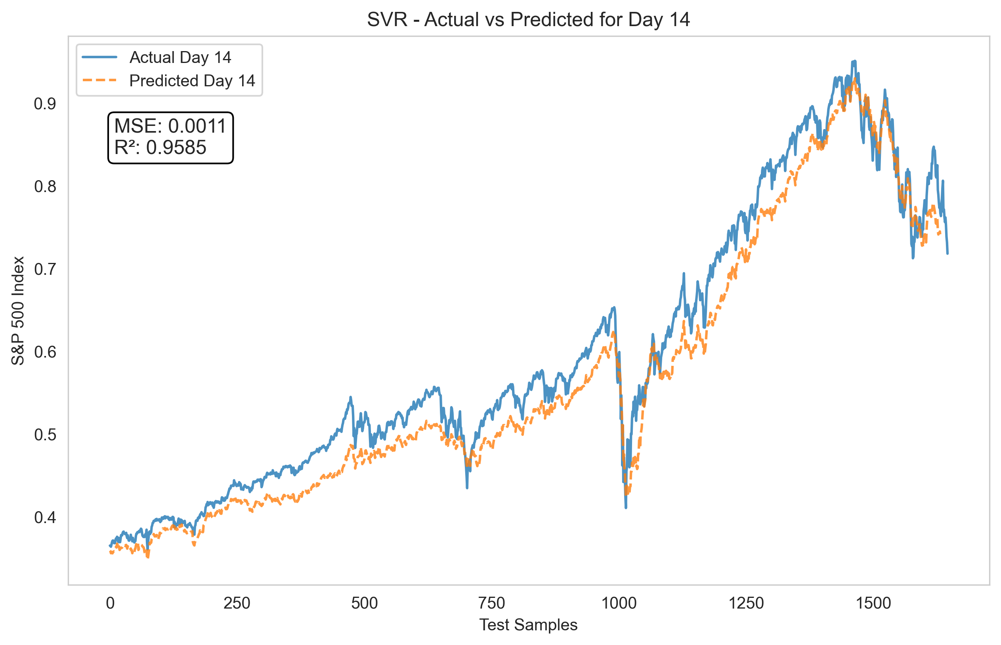

Slide 30
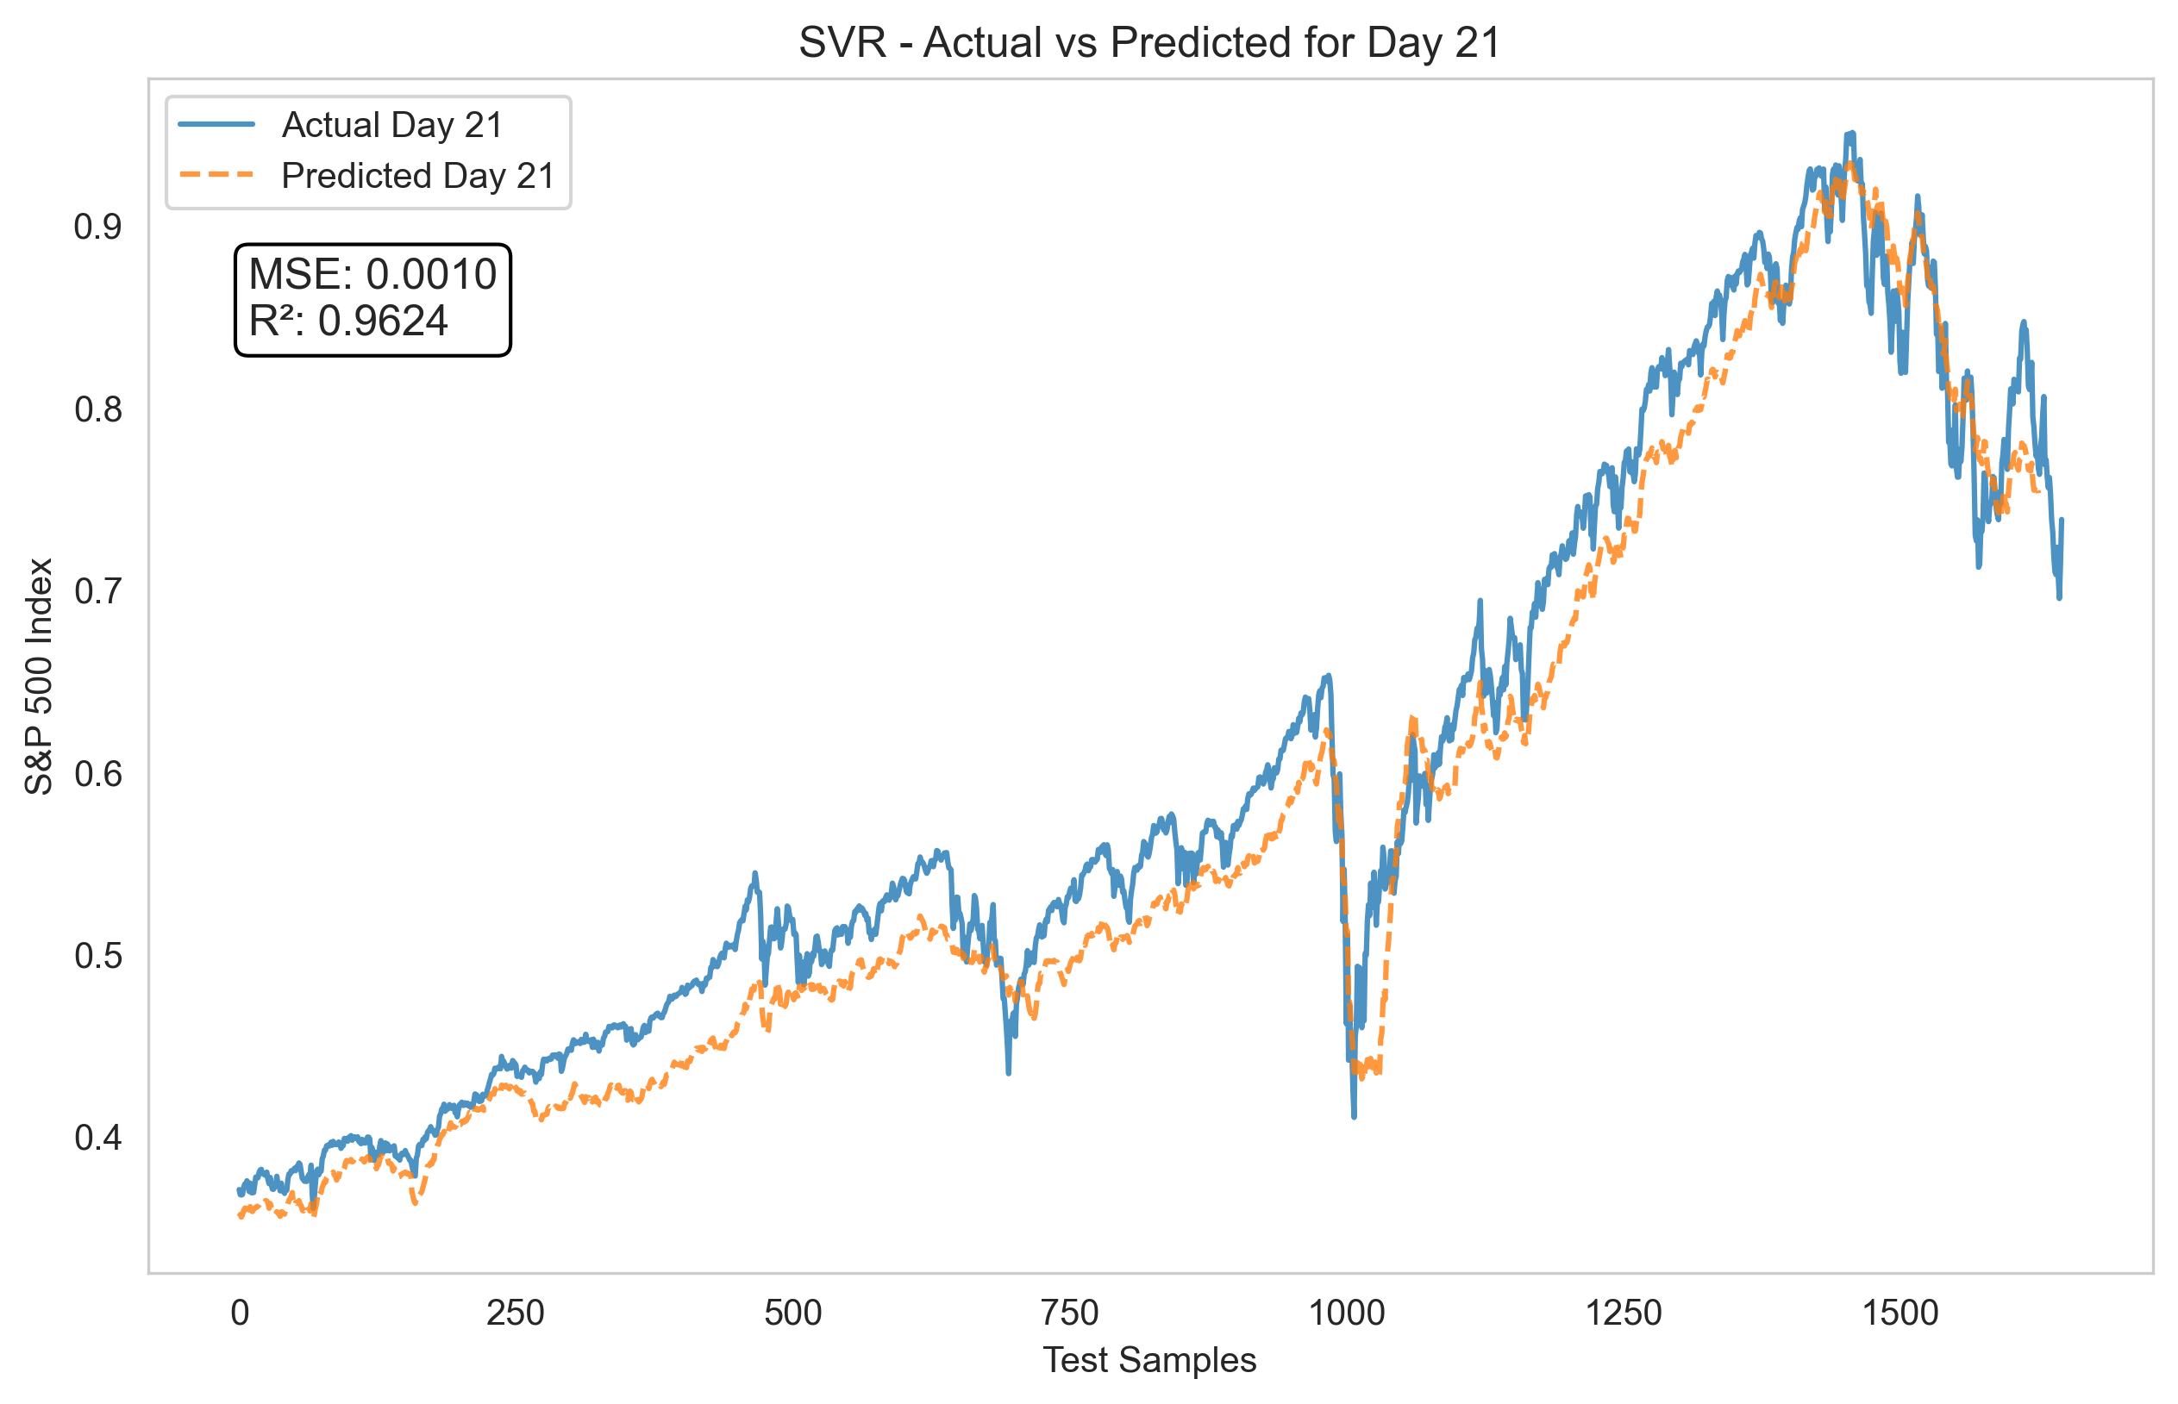

Slide 31


Slide 32
Conclusions
Feature Engineering:
Used rolling windows and lagged features to capture market trends over different timeframes.
Used autoencoder embeddings to reduce dimensionality and improve model efficiency.
Predictive Models:
Tested Linear Regression, Ridge Regression, and SVR for forecasting the S&P 500.
Ridge Regression performed the best, followed by Linear Regression and SVR.
Notes:
- *Tuning Parameters for Ridge & SVR:*
- *Ridge:* α (L2 penalty) optimized.
- *SVR:* Kernel parameters (C, epsilon, gamma) optimized.
- *Tuning the Autoencoder:*
- Encoding dimension (10–30)
- Hidden layer size (128–512)
- Dropout rate (0.1–0.3)
- Learning rate, L1 penalty, weight decay

Slide 33
Future Work
Deep Learning Approaches: Explore LSTMs for sequential dependencies and Transformers for capturing long-range patterns.
Expanded Feature Set: Incorporate additional economic indicators such as interest rates, GDP, and consumer sentiment.
Extended Forecasting Horizon: Move beyond the current 28-day predictions for more robust long-term forecasting.
Notes:
- *Tuning Parameters for Ridge & SVR:*
- *Ridge:* α (L2 penalty) optimized.
- *SVR:* Kernel parameters (C, epsilon, gamma) optimized.
- *Tuning the Autoencoder:*
- Encoding dimension (10–30)
- Hidden layer size (128–512)
- Dropout rate (0.1–0.3)
- Learning rate, L1 penalty, weight decay

